Slide 1
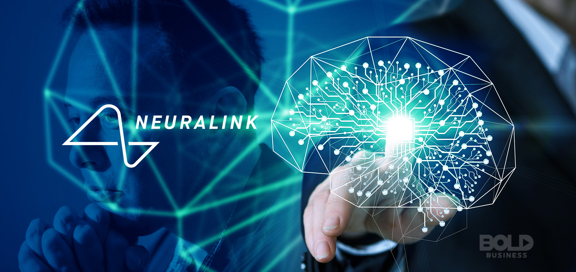
Deepti Ramani

Slide 2
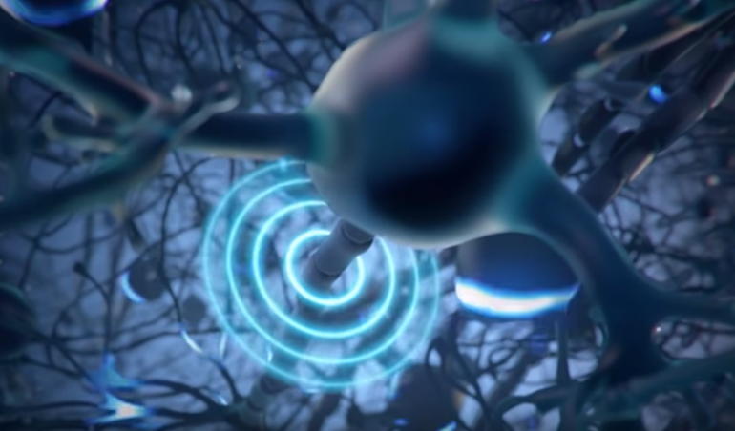
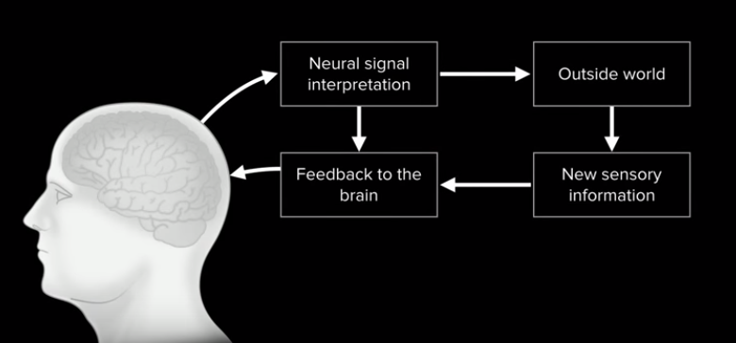
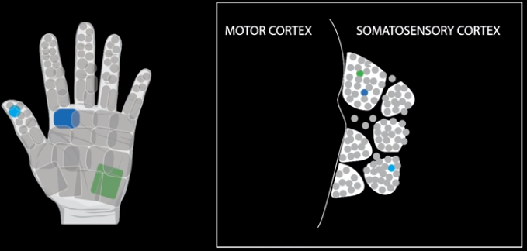
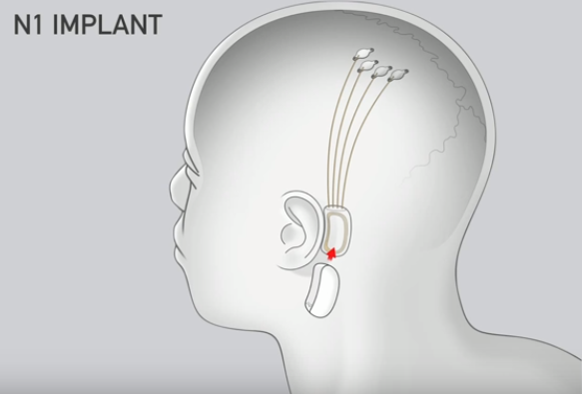
NEURALINK
The brain sends messages to other parts of the body by using an elaborate, complex system of neurons. Neurons communicate with each other using chemical signals called neurotransmitters, from the axon of one neuron in response to an electrical spike called an action potential. These action potentials produce an electric field that can be detected by placing electrodes nearby, essentially allowing information represented by a neuron to be recorded [5].
Machine
[5]
[5]
The technology contains four sensors: three in motor areas and one in a somatosensory area. These sensors are connected to a chip behind the ear by ultra-thin wires tunneled under the scalp [3]. The chip is connected wirelessly to a wearable device called a link, containing a Bluetooth radio and battery that activates the implant [5].
[5]
Neuralink hopes to use this technology to allow people to control devices like mobile phones and Bluetooth mice and keyboards, and eventually robotic limbs.
In addition, the diagram above shows how Neuralink can also provide users with haptic feedback to specific parts of the body, sending impulses to the brain that simulate what happens when a certain stimulus occurs [5].
[5]

Slide 3
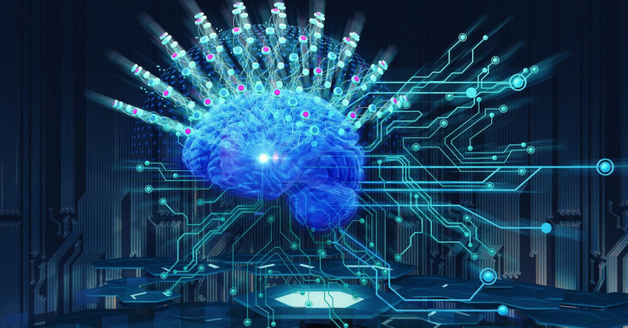
Tools Used
Snipping Tool
Photoshop
Microsoft Word

Slide 4

Introduction
Designed by Elon Musk
Allows humans to access more of their brain functions
Intended to serve as an interface between the brain and a machine
“Achieve symbiosis between humans and AI”

Slide 5
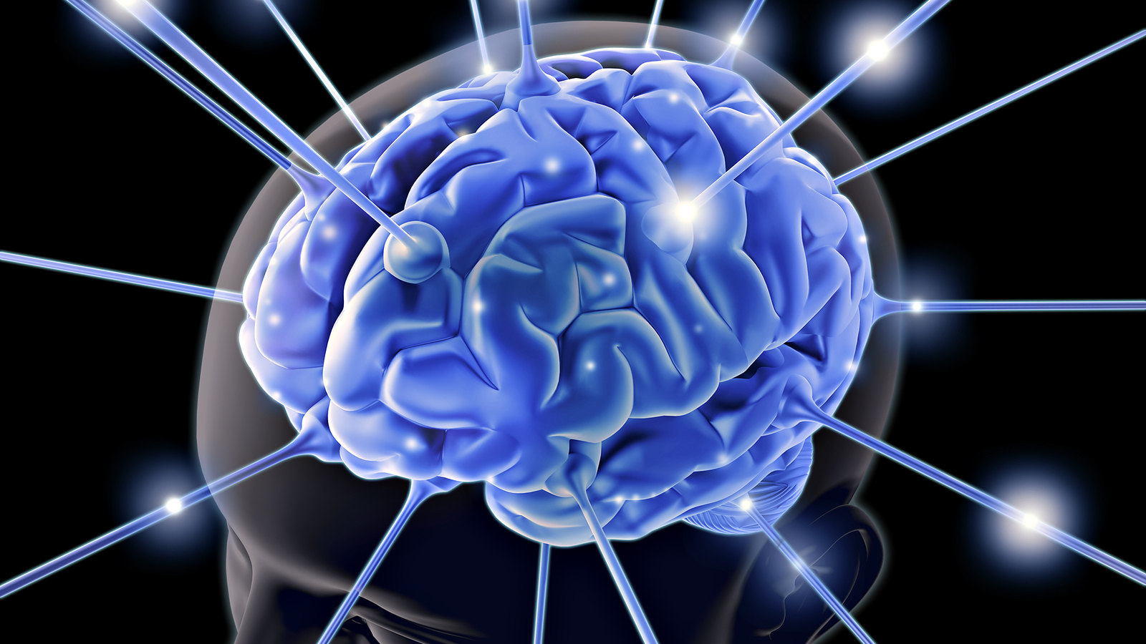
Pros and Cons
Can help those who have lost a limb gain more autonomy
Allows people to control and receive information from machines using their brains
Enables haptic feedback by recording which areas of the brain are stimulated upon touch -> stimulate these areas when people use robotic prostheses to touch something similar
Result in more accurate, advanced robotic limbs and prosthetics.
Lack of privacy
Uses Bluetooth to interface between the chip implant and external machines
Makes it possible for wireless transmissions to be captured
Can track geographical movements, surveillance

Slide 6
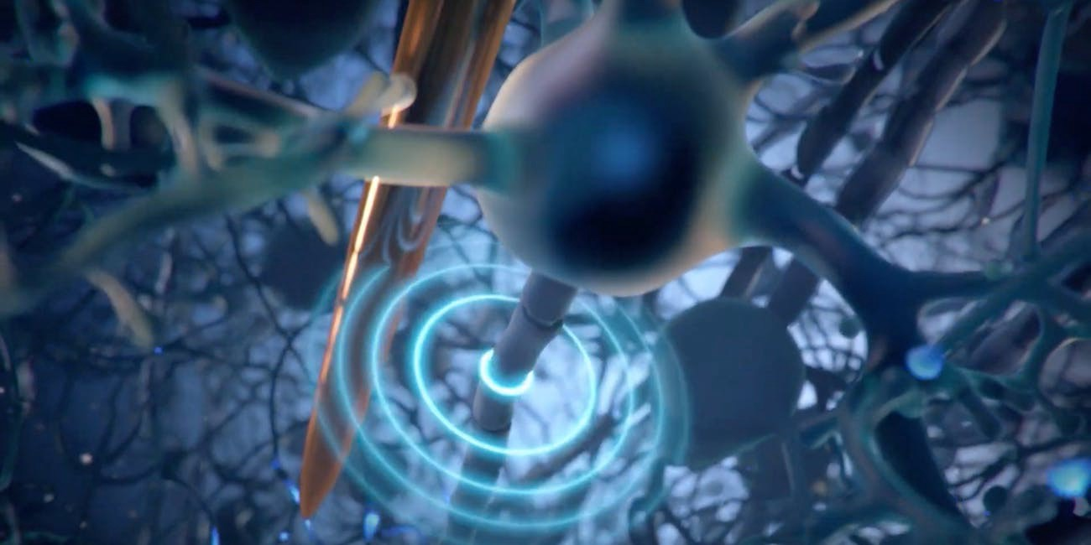
How It Works
Electrical signals sent into and received from the brain.
When a neuron receives enough of a specific neurotransmitter, an action potential gets fired, causing the neuron to continue passing on the message it received.
Action potentials produce an electric field, which can be detected by electrodes, allowing the message to be recorded
This is then sent to a chip implanted behind the ear, which reads and interprets it
Bluetooth security
By using Bluetooth to open up a channel for two devices to communicate, there is a greater opportunity for man-in-the-middle attacks to occur, where a third party can access private data

Slide 7
Works Cited
[1]
Bocetta, Sam. "What are the Security Implications of Elon Musk's Neuralink?" CSO, 1 Aug. 2019, https://www.csoonline.com/article/3429361/what-are-the-security-implications-of-
elon-musks-neuralink.html
[2]
Hamilton, Isobel Asher. "We Spoke to 2 Neuroscientists About How Exciting Elon Musk's Neuralink Really Is." Business Insider, 6 Oct. 2019, https://www.businessinsider.com/we-spoke-to-2-neuroscientists-about-how-exciting-elon-musks-neuralink-really-is-2019-9
[3]
Lopatto, Elizabeth. "Elon Musk Unveils Neuralink’s Plans For Brain-reading ‘Threads’ and a Robot to Insert Them." TheVerge, 16 Jul. 2019, https://www.theverge.com/2019/7/16/20697123/elon-musk-neuralink-brain-reading-thread-robot
[4]
Markman, Jon. "Elon Musk's Neuralink is Sci-FI Made Real." Forbes, 30 Aug. 2019, https://www.forbes.com/sites/jonmarkman/2019/08/30/elon-musks-neuralink-is-sci-fi-made-real/#3fed797c4e2f
[5]
Neuralink. “Neurolink Launch Event” YouTube, commentary by Elon Musk, Max Hodak, Matthew MacDougall, Vanessa Tolosa, DJ Seo, and Philip Sabes, 16 Jul. 2019, https://www.youtube.com/watch?v=r-vbh3t7WVI&feature=youtu.be.
[6]
Scammell, Robert. "Neuralink Security "Has to be Solid" to Avoid Brain Hacking." Verdict, 24 Jul. 2019, https://www.verdict.co.uk/neuralink-security-brain-hacking
[7]
Stewart, Ryan. "Latest Bluetooth Hacking Techniques Expose New Attack Vectors For Hackers." Cyware, 6 Jan. 2019, https://cyware.com/news/latest-bluetooth-hacking-techniques-expose-new-attack-vectors-for-hackers-a16cfb5e

